Slide 1
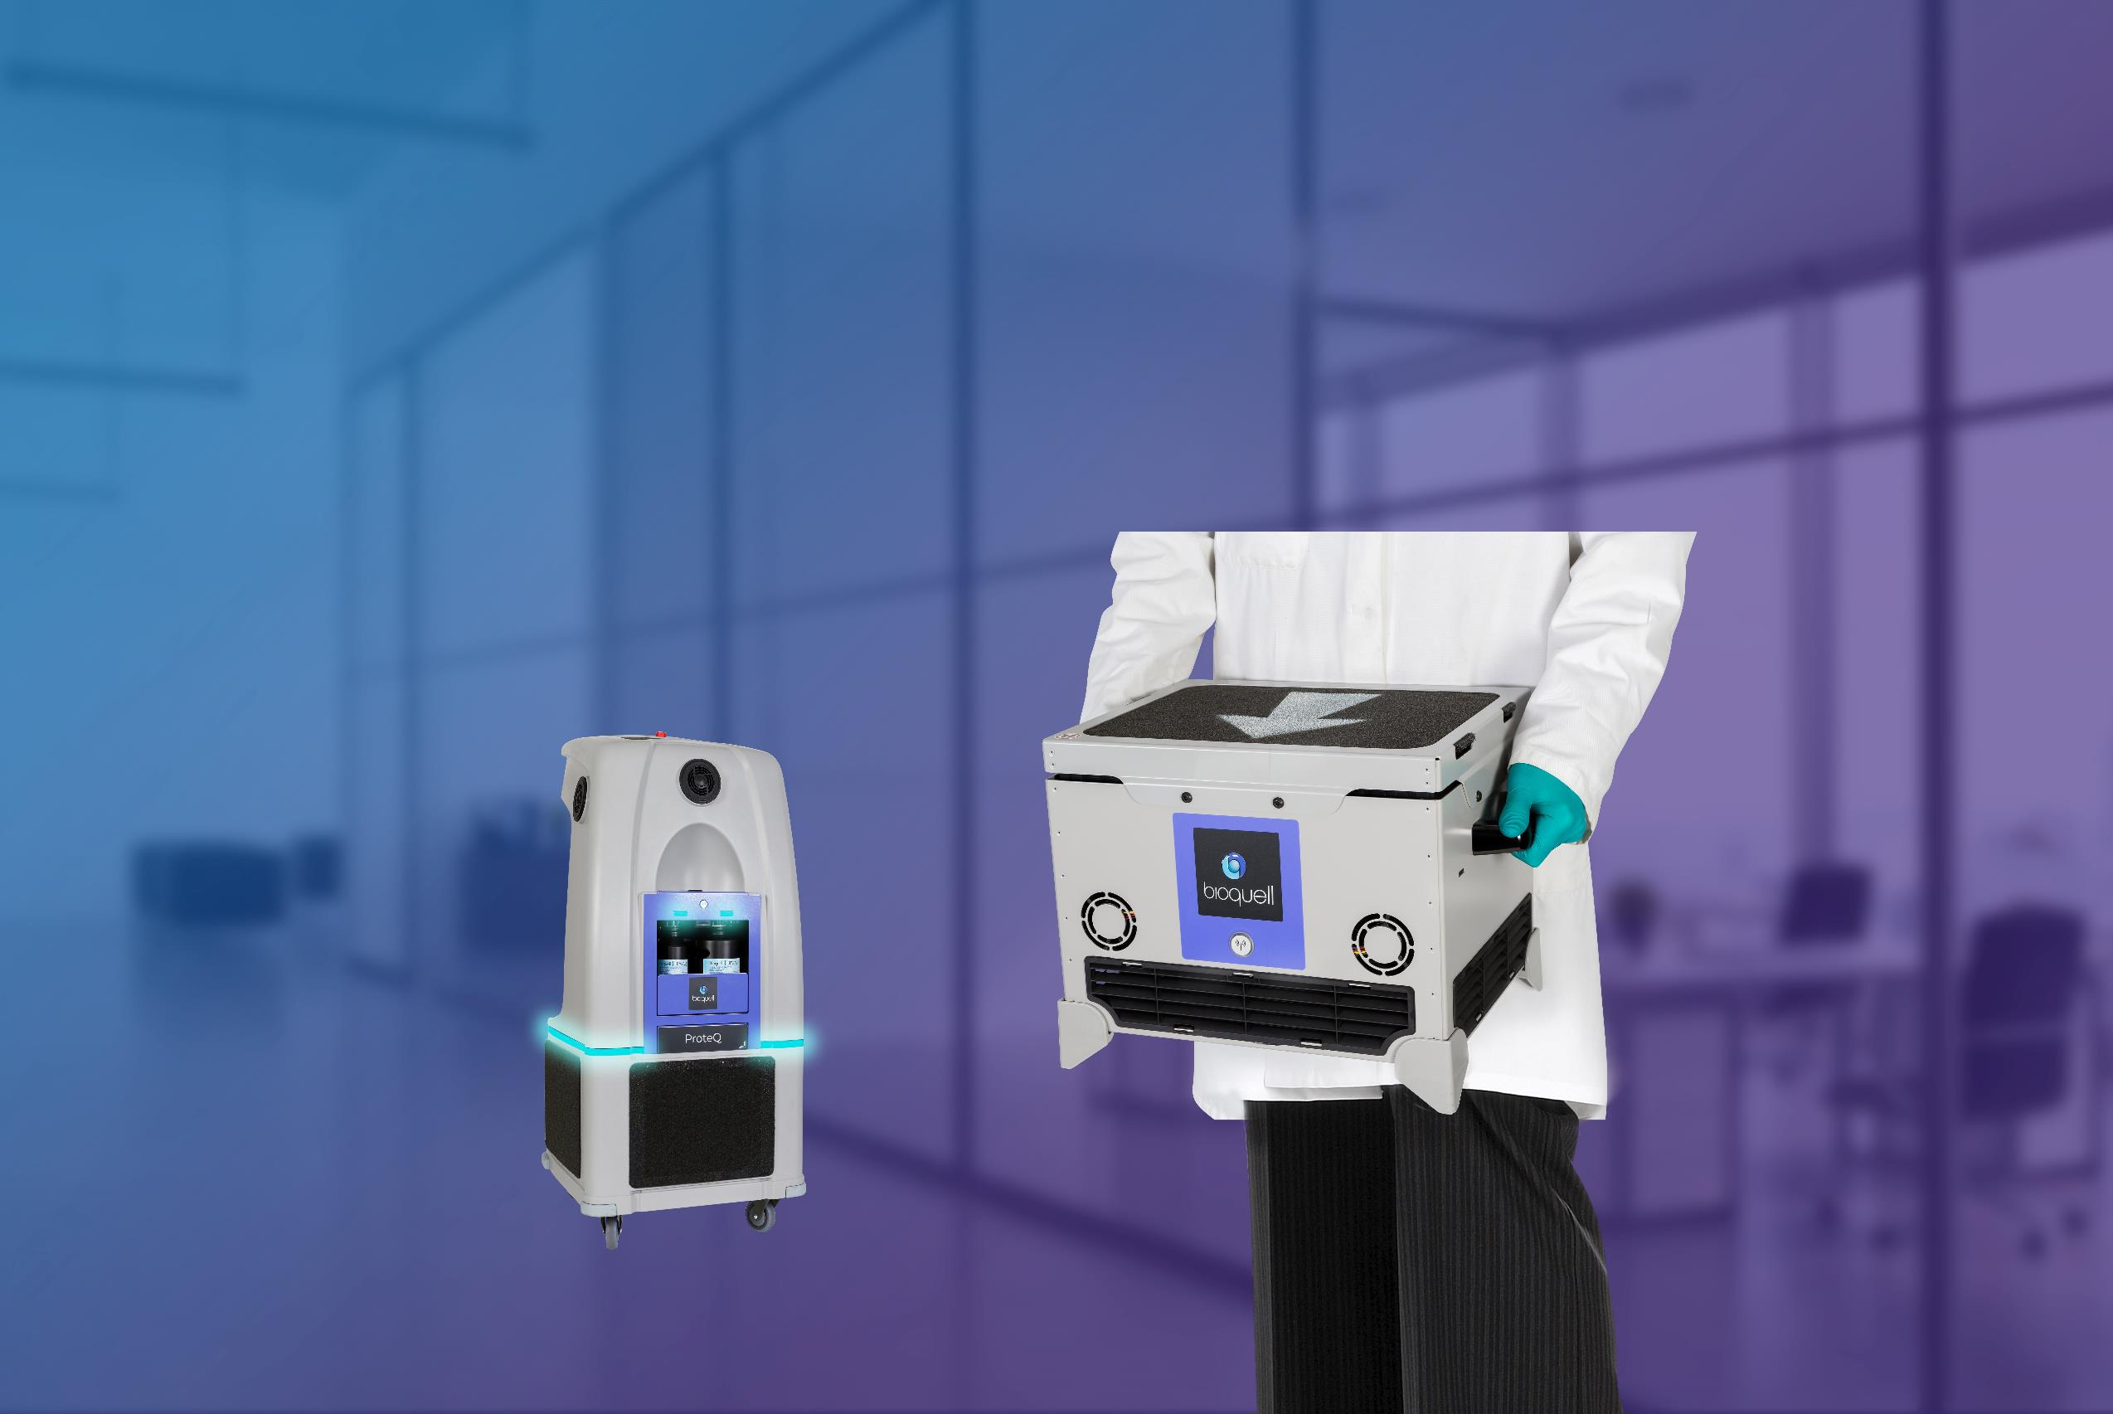

Bioquell Introduction
START
Notes:
Hello and welcome to the ‘Bioquell Introduction’ course.
Please click the START button to begin!

Slide 2


Learning Objectives
You will be able to:
Explain the Hydrogen Peroxide Vapor process
List the key applications of Bioquell
Explain the solutions for health care
Explain the Bioquell RBDS works
Identify the system for enclosures
Click Next to continue.
Notes:
So…what can you expect to get out of this course?
By the end of this course, you will be able to explain the Hydrogen Peroxide Vapor process, list the key applications of Bioquell, explain the solutions for health care, explain the Bioquell RBDS works, and identify the system for enclosures.

Slide 3
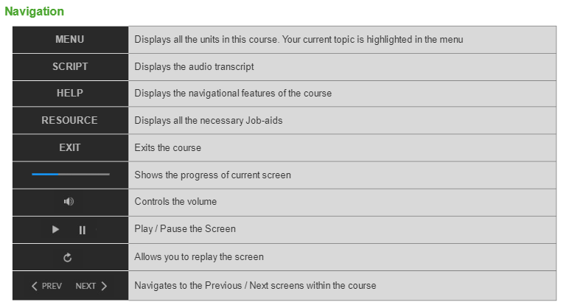
Navigation
Click Next to continue.
Notes:
You also need to understand how to navigate through this course.

Slide 4

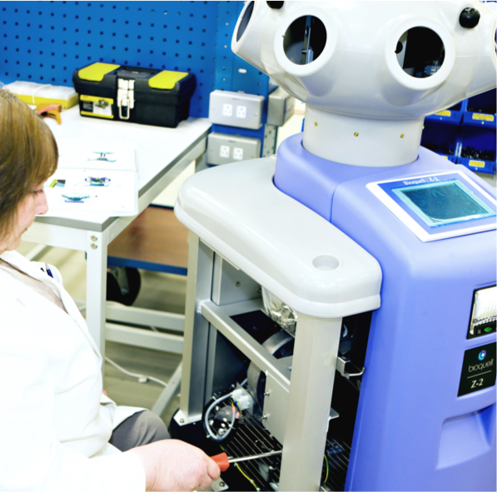
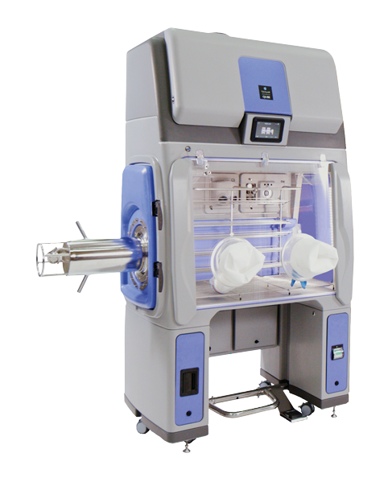
Who is Bioquell?
World leader in Hydrogen Peroxide Vapor decontamination
Specialized in:
Design
Manufacture
Supply of high-level:
Bio-decontamination generators
Systems and services
Used by:
Pharmaceutical
Biosafety
Food
Drink
Healthcare
Click Next to continue.
Notes:
Bioquell is the world leader in Hydrogen Peroxide Vapor decontamination.
It is highly specialized in design, manufacture and supply of high-level bio-decontamination generators, systems and services. Bioquell products and services are used by Pharmaceutical, Biosafety, Food, Drink and Healthcare sectors.

Slide 5



Fun Facts About Bioquell
42 Pharmaceutical Companies have either purchased Bioquell’s equipment or used decontamination services
Bioquell technology was deployed for Ebola related issues in Europe & USA
18times
250Years
250,000 decontamination cycles are successfully performed over worldwide
Bioquell have been operating within the infection control industry
Click Next to continue.
Notes:
Did you know…
Of the top 50 Pharmaceutical Companies in the world, 42 have either purchased Bioquell’s equipment or used decontamination services. Having successfully performed over 250,000 decontamination cycles worldwide, Bioquell is established as the gold standard in eliminating pathogens. Bioquell technology was deployed 18 times for Ebola related issues in Europe & USA, during the 2014-2016, West African crisis. Bioquell have been operating within the infection control industry for over 250 years.

Slide 6
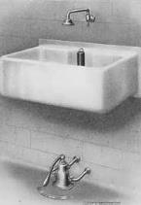
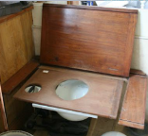
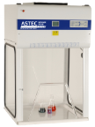
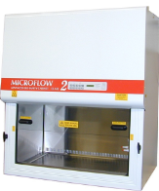
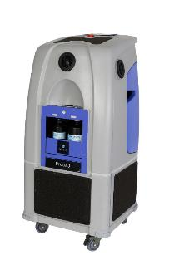
Over 250 Years of Infection Control Experience
Sanitary Equipment
Bedpan Washers
British Sterilisers
Biological Safety Cabinets
Hydrogen Peroxide Technology
1730
1820
1940
1970
2000
Click Next to continue.
Notes:
Take a minute to look at the Bioquell’s infection control experience over 250 years,

Slide 7
Global Offices and Distributors
Global Offices
Germany
Ireland
France
United Kingdom
USA
China
Singapore
Click the arrow to learn more.
Notes:
Bioquell has number of offices around the world. The company was originated in UK, followed by USA, France, Singapore, China, Germany and Ireland.
Click the arrow to learn more.

Slide 8

Global Offices and Distributors
Distributors
Click the arrow to learn more.
Click Next to continue.
Notes:
Here are the distributors around the world.

Slide 9






















Bioquell Partnerships
Partnered With:
Click Next to continue.
Notes:
Take a minute to look at few companies like pharmaceutical companies as well as leading research institutes partnered with Bioquell.

Slide 10




Course Structure
Our Technology
Systems for
Rooms
Solutions for
Healthcare
RBDS
Systems for
Enclosures
Bioquell Qube
Summary
Notes:
This course will provide a brief overview of Bioquell, how it works and the products and services.
Here’s how the course is structured:
In Unit 1, you’ll be briefed about Bioquell Technology.
Unit 2 takes you through systems for room spaces.
In Unit 3, you will be introduced to solutions for healthcare.
Then in unit 4 you’ll get to know about the Rapid Bio Decontamination Service (RBDS).
Unit 5 takes you through systems for enclosures.
In Unit 6, will take you through the Bioquell Qube’s applications and selling points.
Finally, we’ll wrap up with summary.

Slide 11
Course Structure
Our Technology
Systems for
Rooms
Solutions for
Healthcare
RBDS
Systems for
Enclosures
Bioquell Qube
Summary
Notes:
Let’s begin with an introduction to our technology.

Slide 12
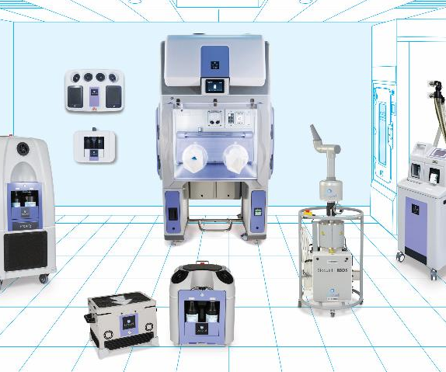
Our Technology
35% Hydrogen Peroxide Vapor Technology
Validated, 6-log sporicidal kill on every exposed surface
Wide efficacy spectrum against bacteria, viruses, spores and more
Breaks down into residue free oxygen and water
Compatible with sensitive materials and products
Click Next to continue.
Notes:
Shown here are some of the features of Bioquell.

Slide 13
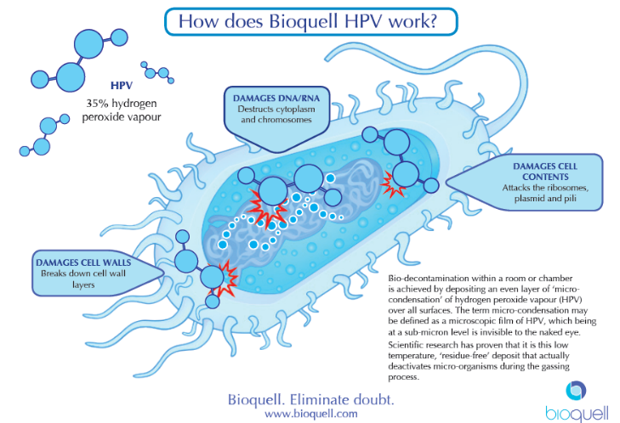


How does Bioquell HPV work?
Microorganisms deactivated by a number of mechanisms including oxidation of the cell wall
Click Next to continue.
Notes:
So, how does Bioquell HPV work?
Bioquell HPV affects the micro-organisms by damaging cell walls, DNA/RNA and cell contents.

Slide 14
How does Bioquell HPV work?
X
Bio-decontamination within a room or chamber is achieved by depositing an even layer of micro-condensation of hydrogen peroxide vapour (HPV) over all surfaces. The term micro-condensation may be defined as a microscopic film of HPV, which being at a sub-micron level is invisible to the naked eye.
Scientific research has proven that it is this low temperature, ‘residue-free’ deposit that actually deactivates micro-organisms during the gassing process.
Microorganisms deactivated by a number of mechanisms including oxidation of the cell wall
Click Next to continue.

Slide 15
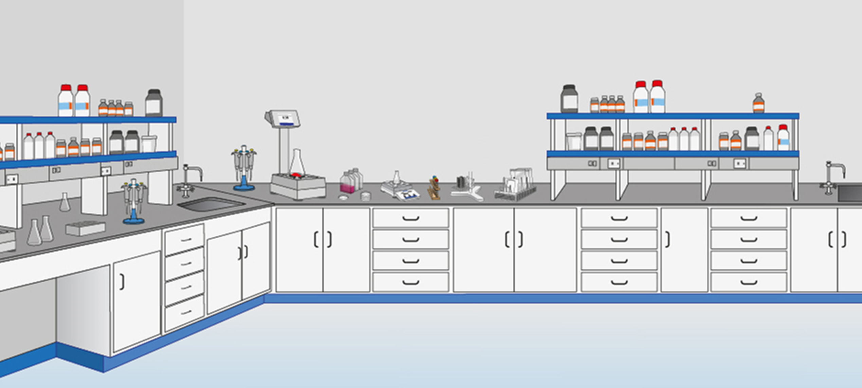


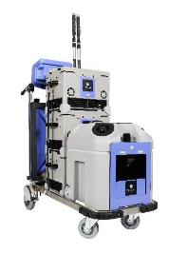



Hydrogen Peroxide Vapor Process
Click each step to learn about it.
Step 2
Vaporisation
Step 3
Dwell
Step 1
Preparation
Step 4
Aeration
Notes:
With Bioquell Hydrogen Peroxide Vapour, we can achieve fast, efficient, and residue-free decontamination in four easy steps.
Click each step to learn about it.

Slide 16

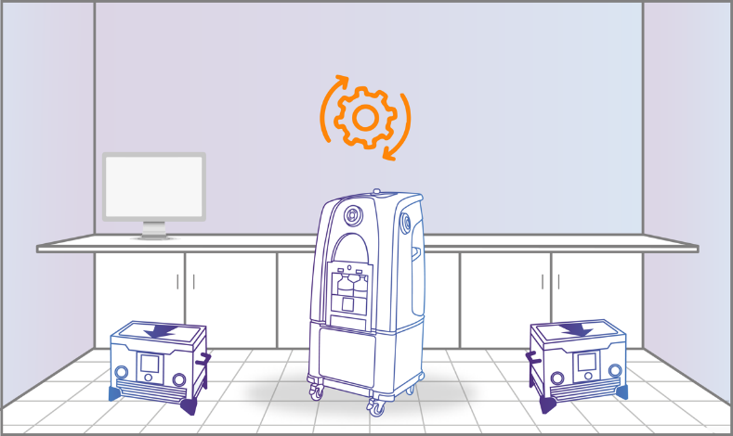
Hydrogen Peroxide Vapor Process
Step 1: Preparation
X
Click each step to learn about it.
The Bioquell decontamination system warms up, getting ready to disperse the vapor.
Step 2
Vaporisation
Step 3
Dwell
Step 1
Preparation
Step 4
Aeration
Notes:
The Bioquell decontamination system warms up, getting ready to disperse the vapor. You do not need to reach or wait for temperature or humidity levels to begin.

Slide 17
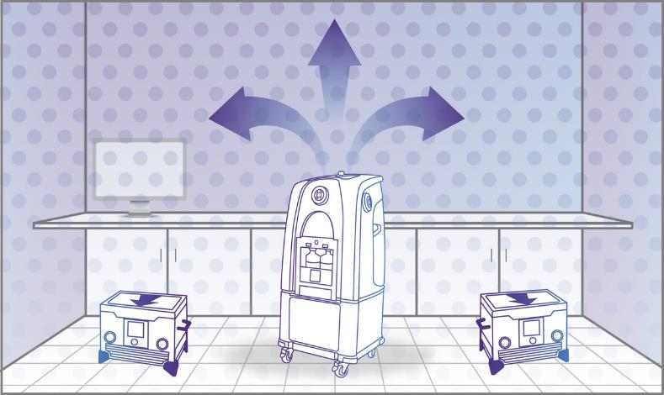
Hydrogen Peroxide Vapor Process
Step 2: Vaporisation
X
Click each step to learn about it.
The Bioquell decontamination system emits the vapor into the enclosed area and fills the space pushing the vapour against every exposed surface
Step 2
Vaporisation
Step 3
Dwell
Step 1
Preparation
Step 4
Aeration
Notes:
The Bioquell decontamination system emits the vapour into the enclosed area and fills the space, pushing the vapour against every exposed surface, including surrounding complex shapes and crevices.

Slide 18
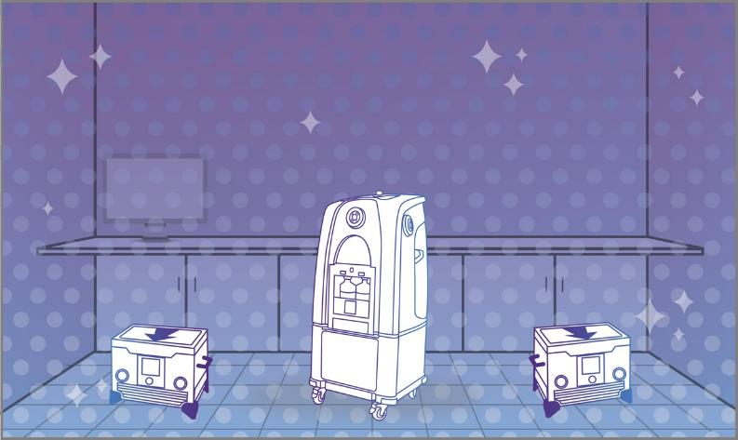
Hydrogen Peroxide Vapor Process
Step 3: Dwell
X
Click each step to learn about it.
The enclosed area is at a standstill, allowing the peroxide to dwell on every exposed surface and kill pathogens.
Step 2
Vaporisation
Step 3
Dwell
Step 1
Preparation
Step 4
Aeration
Notes:
With vaporization complete, the enclosed area is at a standstill, allowing the peroxide to dwell on every exposed surface and kill pathogens.
Microorganisms deactivated by oxidation of the cell wall.

Slide 19
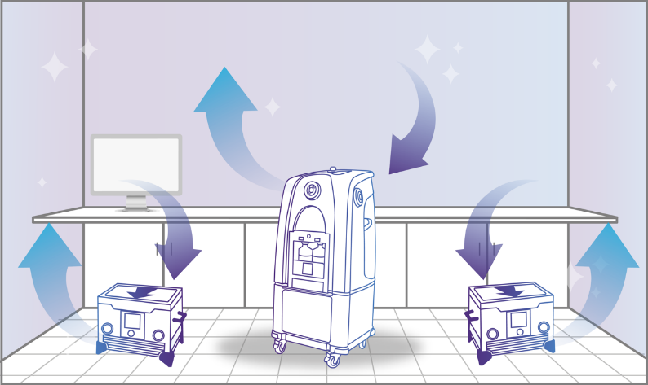
Hydrogen Peroxide Vapor Process
Step 4: Aeration
X
Click each step to learn about it.
Bioquell aeration units convert the vapor into water vapor and oxygen using catalytic conversion.
Step 2
Vaporisation
Step 3
Dwell
Step 1
Preparation
Step 4
Aeration
Notes:
Your HVAC system, high-powered Bioquell aeration units using catalytic conversion or a combination of both now safely remove all of the Hydrogen Peroxide Vapour from the enclosed area. When aerated with Bioquell units, the vapour is converted into water vapour and oxygen.

Slide 20







Bioquell Applications
The key applications of Bioquell are:
Compounding
pharmacies
Material transfer
solutions
Infection control
in hospitals
Animal research
facilities
Biosafety labs (BSL)
of all levels
Biopharmaceutical
production
Click Next to continue.
Notes:
The key applications of Bioquell are:
Compounding Pharmacies,
Material transfer solutions,
Infection control in hospitals,
Animal research facilities,
Biosafety labs (BSL) of all levels, and
Biopharmaceutical production.

Slide 21
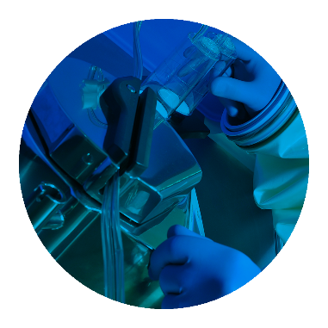
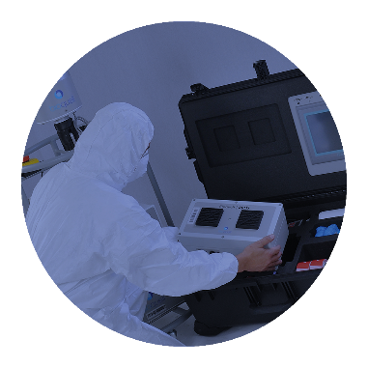
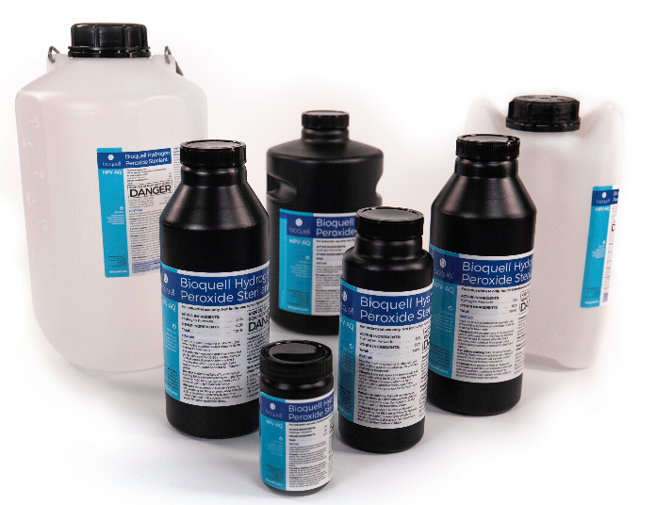
Our Total Solutions
Systems
Consumables
Services
Click Next to continue.
Notes:
Our solutions include systems, consumables, and services.

Slide 22
Course Structure
✓
Our Technology
Systems for
Rooms
Solutions for
Healthcare
RBDS
Systems for
Enclosures
Bioquell Qube
Summary
Notes:
Let’s look at systems for rooms.

Slide 23
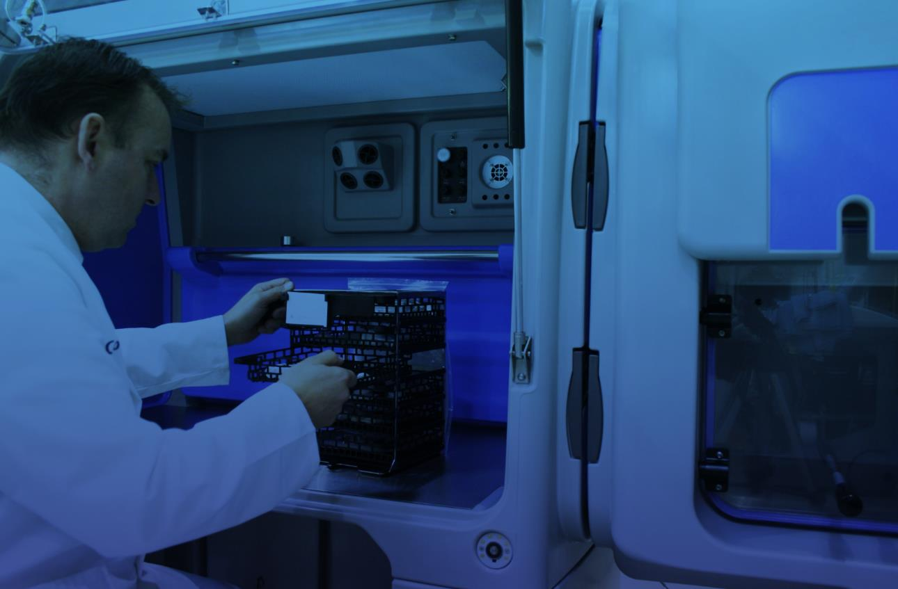
Systems for Rooms
Click each tab to learn about it.
Bioquell Z-2 (obsolete)
Bioquell ProteQ
Bioquell SeQure
Fixed Room Decontamination
Bespoke Fixed Systems
Notes:
Bioquell systems and services provide the vital assets for safe and compliant 6-log pathogen kill for work that leads profession. Bioquell systems include Bioquell Z-2, Bioquell ProteQ, Bioquell SeQure, Fixed Room Decontamination, and Bespoke Fixed Systems.
Please note that Bioquell Z-2 has become obsolete.
Click each tab to learn about it.

Slide 24
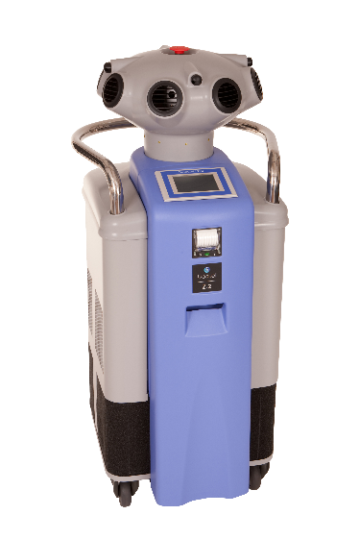
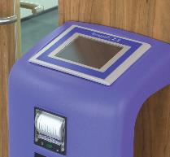
Systems for Rooms
Bioquell Z-2 (obsolete)
X
Click each tab to learn about it.
Bioquell Z-2 (obsolete)
Room / zone bio-decontamination applications
High-capacity room-based bio-decontamination (up to 250m³) with easy-to-use touchscreen interface
Employ GMP-compliant timed cycles or environment-specific parametric cycles
Multiple cycle parameters storage provides greater easy of use in multiple sites across a large facility
Sold over 800 units worldwide between 2006-2019
Bioquell ProteQ
Bioquell SeQure
Fixed Room Decontamination
Bespoke Fixed Systems
Notes:
The Bioquell Z-2 is a complete solution for room / zone bio-decontamination. It is able to bio-decontaminate rooms/laboratories up to 250m³ in a GMP regulated environment using GMP-compliant software. It also has a unique parametric cycle control, eliminating the need for gas cycle development studies in non-GMP facilities. The Bioquell Z-2 provides enhanced HPV delivery and control via a simple touch panel interface. It is ideal for sterilising all surfaces within a room providing a 6-log reduction in environmental bioburden, the same standard used for validating steam sterilisers / autoclaves. The Bioquell Z-2 is suitable for facility / area bio-decontamination in GMP and non-GMP cleanrooms, aseptic processing lines, biologic manufacturing plants, biomedical facilities and biosafety / biosecurity areas.

Slide 25
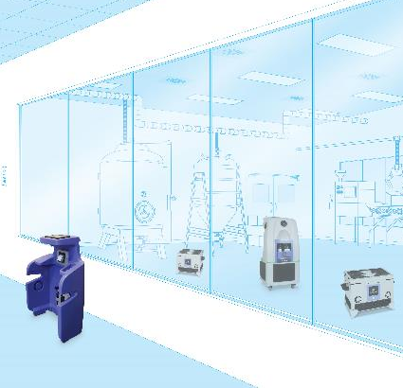
Systems for Rooms
Bioquell ProteQ
X
Click each tab to learn about it.
GMP Generator
Wireless control
Integrated aeration unit for fast cycles
Printer and electronic data capture options
Capacity of 400m³ timed and parametric cycles
Space to carry accessories and additional aeration units
Markets include:
Pharma
Biomedical
Biosafety
Laboratory
Healthcare
Typical application – When client has multiple rooms requiring relatively fast decontamination
Bioquell Z-2 (obsolete)
Aeration units
Bioquell ProteQ
Main structure of the system
Bioquell SeQure
Fixed Room Decontamination
Wireless control
Bespoke Fixed Systems
Notes:
The latest achievement from Bioquell, the Bioquell ProteQ offers a modular approach to room and zone decontamination. Enhanced distribution capabilities, networking options, wireless technology and advanced aeration capabilities make this system, the ideal solution for contamination elimination in the smallest labs to the largest production areas.

Slide 26
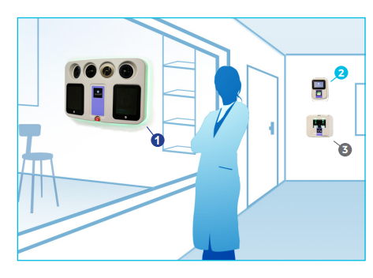
Systems for Rooms
Bioquell SeQure
X
Click each tab to learn about it.
GMP Generator placed inside target area but fixed to wall
Fast cycles
Capacity of 150m³ using timed or parametric control
Recommended minimum distance to load 300 mm
Thermal Printer for cycle data
Markets include: Pharma, Biomedical Biosafety, Laboratory & Healthcare
Typical applications:
Client has a single large room requiring frequent decontamination
High risk applications e.g. Hospital Isolation units
Bioquell Z-2 (obsolete)
Bioquell ProteQ
Bioquell SeQure
Fixed Room Decontamination
Bespoke Fixed Systems
Limitation
Multiple rooms may require additional generators
Notes:
The Bioquell SeQure is the fixed and compact wall-mounted bio-decontamination system that eradicates the bio-burden of microorganisms and other contaminants threatening your research and production facility.

Slide 27
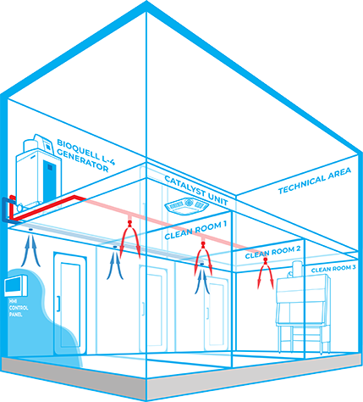
Systems for Rooms
Fixed Room Decontamination
X
GMP Generator placed outside of target area typically in unclassified / technical area, saving space
Facilitates the decontamination of complex multiple room / enclosure layouts and patterns
Fully automated and can integrate with client BMS, reducing risk of human error and setup / downtime
Markets include: Pharma, Biomedical, Laboratory, Biosafety
Typical applications:
Client has a multiple room / enclosure area requiring frequent decontamination
Preference for equipment to be located outside of zone
Bioquell Z-2 (obsolete)
Bioquell ProteQ
Click each tab to learn about it.
Bioquell SeQure
Fixed Room Decontamination
Bespoke Fixed Systems
Limitations
Increased capital cost
Extended cycle times
Notes:
The Bioquell Integrated Building Decontamination System is a fully integrated solution designed for frequent or routine decontamination of the same area within a facility. This could be anything from a containment lab or multiple material air locks, to a sterile manufacturing core or biomedical holding area. Typically, Bioquell hydrogen peroxide vapor generator(s) are located centrally in a technical or unclassified space, and the vapor is distributed to the areas where it is required either through the building’s ventilation system or a dedicated network of pipes leading to nozzles on the ceiling of the target rooms. With an integrated system, no movement or storage of mobile equipment is required reducing manual setup times, increasing repeatability and removing human error.

Slide 28
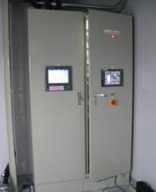
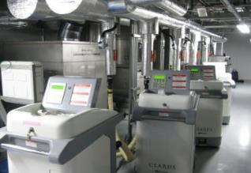
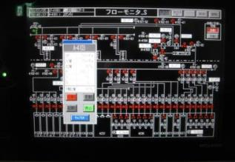
Systems for Rooms
Bespoke Fixed Systems
X
Heater booster fan often used to prevent vapour condensing before reaching the nozzle and to maintain velocity
System uses heat traced & insulated cPVC pipework
Bioquell Z-2 (obsolete)
Bioquell ProteQ
Click each tab to learn about it.
Bioquell SeQure
Fixed Room Decontamination
Bespoke Fixed Systems
Notes:
Heater booster fan often used to prevent vapour condensing before reaching the nozzle and to maintain velocity. System uses heat traced & insulated cPVC pipework.

Slide 29
Course Structure
✓
✓
Our Technology
Systems for
Rooms
Solutions for
Healthcare
RBDS
Systems for
Enclosures
Bioquell Qube
Summary
Notes:
Now let’s take a look at solutions for healthcare.

Slide 30
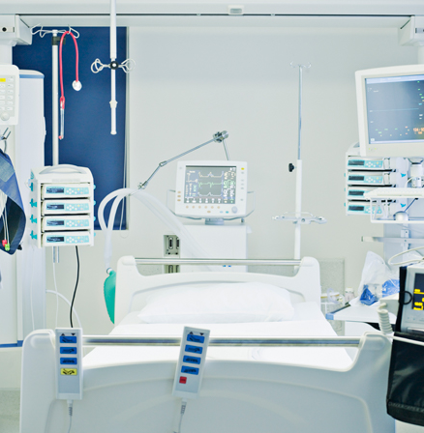
Solutions for Healthcare
Bioquell BQ-50
Bioquell Pod
Click each tab to read more.
Notes:
Let’s look at healthcare solutions in detail.
Click each tab to read about it.

Slide 31
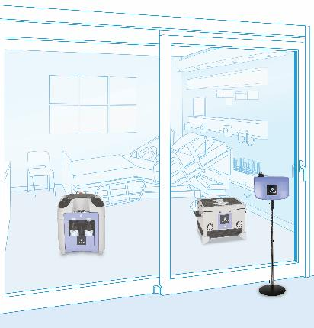
Solutions for Healthcare
Bioquell BQ-50
Bioquell Pod
For use in patient rooms, bays and operating theatres
Single patient room can be decontaminated in c.1 hour (newest in rapid bio-decontamination technology)
Bio-decontamination cycles powered by:
Compact vaporizer unit
High-speed aeration units
Fully automated cycles with single push-button start
Lightweight and easy to transport on trolley

Slide 32
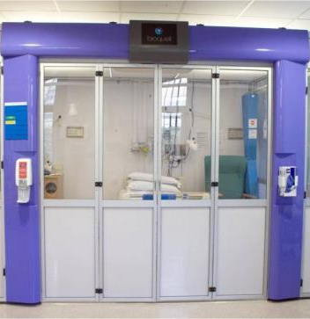
Solutions for Healthcare
Bioquell BQ-50
Bioquell Pod
Enables conversion of open clinical areas into single patient occupancy spaces, preventing the spread of infection between patients
Semi permanent structure made from aluminium bars and Perspex panels
Lower panels for lower section for patient privacy, but transparent upper section for patient visibility
Bifold doors for quick access in emergency
Overhead lights and air handling unit run at positive or negative for patient protection or containment
Click Next to continue.

Slide 33

Course Structure
✓
✓
✓
Our Technology
Systems for
Rooms
Solutions for
Healthcare
RBDS
Systems for
Enclosures
Bioquell Qube
Summary
Notes:
Let’s now look at Rapid Bio Decontamintaion Service (RDBS).

Slide 34
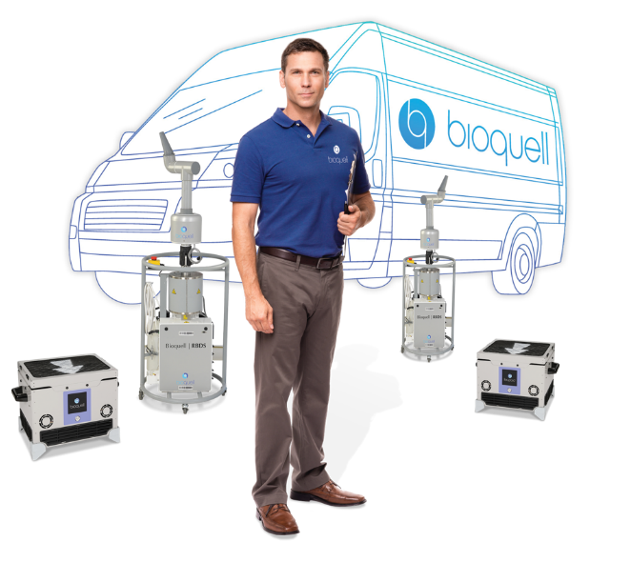
Rapid Bio Decontamination Service (RBDS)
Bioquell equipment and engineers perform decontamination responsibilities for scheduled or emergency situations with detailed reporting.
Completely scalable due to unique RBDS networking capabilities and specialized equipment
Various Service Options:
Scheduled decontamination
Emergency response
Dedicated equipment and guaranteed response times
Click Next to continue.
Notes:
Various service options include scheduled decontamination, emergency response, dedicated equipment and guaranteed response times.
Bioquell equipment and engineers perform decontamination responsibilities for scheduled or emergency situations with detailed reporting. And completely scalable due to unique RBDS networking capabilities and specialized equipment.

Slide 35

How Does Bioquell RBDS Works?
Client Safety Briefing Note
Risk Assessment
We will animate this in the course
Method Statement
Schedule of Works
Final BI Results
Final Report
Certificate of Bio-Decontamination
Initial Customer Enquiry
Site Visit by RBDS Specialist
Quotation & Proposal
Project Documentation
Site Safety Induction
RBDS
Deployment
24-hour BI Results
Click Next to continue.
Notes:
When we have a typically Initial Customer Enquiry it will be followed by a site visit. Once we know the scope of the project, we will provide a quotation and proposal. When we get the order, we do a project documentation. Before we start with the installation, we provide a schedule of work, risk assessment, client safety briefing note, and method statement. After that we do site safety induction and deploy RBDS. Once we perform the decontamination deployment, we will wait for 24 hours to get biological indicate preliminary results and then after 7 days will get the final validated report. Then we issue our final report and certificate of bio-decontamination.

Slide 36
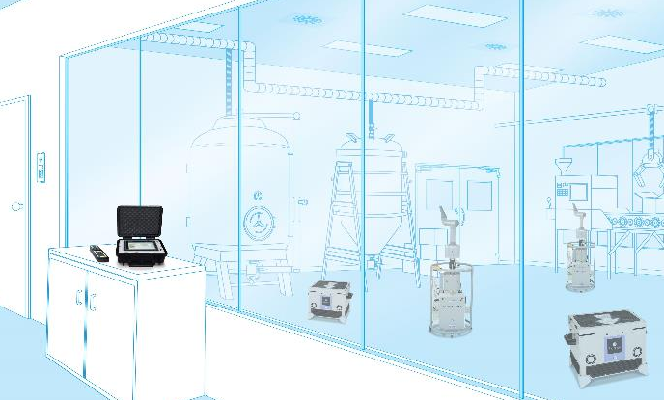
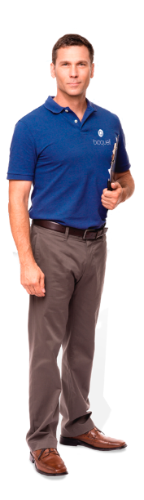
Bioquell RBDS
1
1
3
Click each number to learn more.
2
2
Notes:
Bioquell’s Rapid Bio Decontamination Service (RBDS) can be quickly called upon to eliminate pathogens, stop outbreaks, handle emergency response situations and much more for any size area.
Click each number to learn more.

Slide 37
Bioquell RBDS
VAPORIZERS placed strategically in the zone emit the peroxide
1
1
1
AERATION units:
Push vapor throughout during vaporization phase
Remove peroxide during aeration phase
3
2
2
2
All are handled by BIOQUELL TECHNICIANS
CONTROL MODULE:
Operates all equipment
Displays environmental conditions in the zone
Manages the cycle
3
Click Next to continue.
Notes:
Vaporizers are placed strategically to emit the vapor and can be networked with multiple generators to cover large volume areas safely.
Aeration units help efficiently spread the vapor at the start of the cycle and quickly remove it during the aeration phase.
Control module networks operates all equipment, displays environmental conditions in the zone and manages the cycle
.

Slide 38
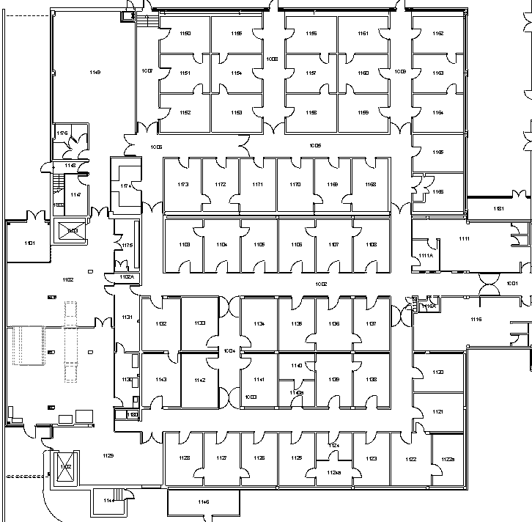
RBDS Deployment
Team and equipment arrive
Equipment unloaded & set-up
Note to Client: We will animate this in the live version.
12
Final set-up and equipment test
Air-conditioning and fire alarms isolated
9
3
6
Gassing Cycle
HVAC re-started
Overnight Aeration

Slide 39
Course Structure
✓
✓
✓
✓
Our Technology
Systems for
Rooms
Solutions for
Healthcare
RBDS
Systems for
Enclosures
Bioquell Qube
Summary
Notes:
Now, let’s go through systems for enclosures.

Slide 40
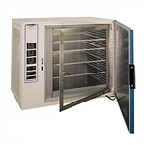
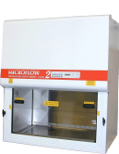
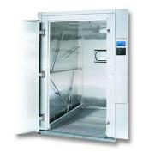
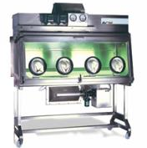
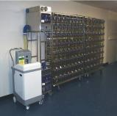
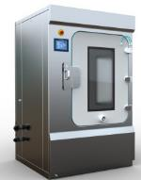
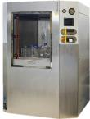
Equipment / Small Enclosure Decontamination
Microbiological
safety cabinets
Rack washers
CO₂ Incubators
Isolators
IVCs
Passboxes
Autoclaves
Click Next to continue.
Notes:
Equipment or small enclosure decontamination can also be achieved with Bioquell. Shown on-screen are some examples of enclosures.

Slide 41
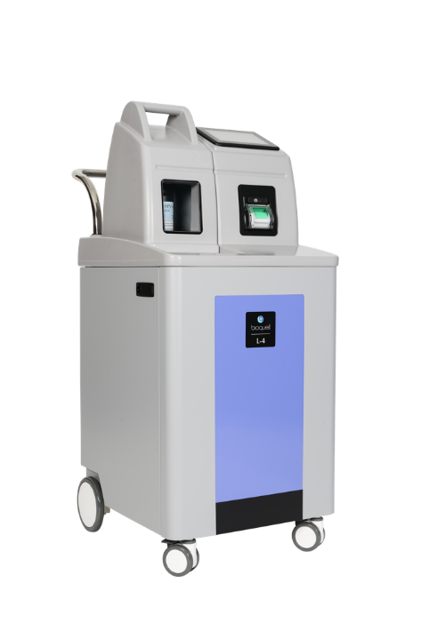
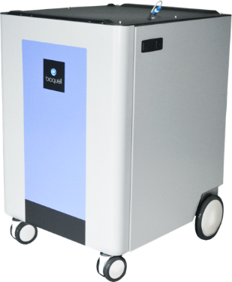
Equipment Decontamination
Click each tab to learn more.
Bioquell L-4
Bioquell IG-2
Mobile solution
Integrated solution
Notes:
The Bioquell L-4 and the Bioquell IG-2 offer a mobile and integrated decontamination solution respectively.
Click each tab to learn more.

Slide 42
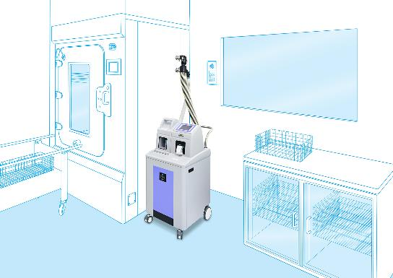
Equipment Decontamination
Click each tab to learn more.
Bioquell L-4
Bioquell IG-2
Enclosure / zone bio-decontamination applications:
Multipurpose mobile HP Vapor generator available in two models
Suitable for isolators, freeze dryers, incubators, filter banks, MSCs, small rooms, pass-throughs, and other GMP-compliant facilities up to 75m³
Can be purchased with gassing head and remote HMI to gas rooms and laboratories in non-regulated areas up to 100m³
Safe ‘no-touch’ bottle (500mL-5L) loading ensures operator protection
Easy-to-use color touchscreen
Limitations
Notes:
Bioquell L-4 is a multipurpose mobile Hydrogen Peroxide Vapor generator available in two models for flexibility of use. Suitable for isolators, freeze dryers, incubators, filter banks, MSCs, small rooms, pass-throughs, and other GMP-compliant facilities up to 75m³. It can be purchased with gassing head and remote HMI to gas rooms and laboratories in non-regulated areas up to 100m³. The safe ‘no-touch’ bottle (500mL-5L) loading ensures operator protection and it comes with a color touchscreen.
Click the Limitations tab to learn more.

Slide 43
Equipment Decontamination
Click each tab to learn more.
Bioquell L-4
Bioquell IG-2
Enclosure / zone bio-decontamination applications:
Multipurpose mobile HP Vapor generator available in two models for flexibility of use.
Suitable for isolators, freeze dryers, incubators, filter banks, MSCs, small rooms, pass-throughs, and other GMP-compliant facilities up to 75m³
Can be purchased with gassing head and remote HMI to gas rooms and laboratories in non-regulated areas up to 100m³
Safe ‘no-touch’ bottle (500mL-5L) loading ensures operator protection
Easy-to-use color touchscreen
X
Limitations
Space occupying in classified area
Low Injection Rate
Limitations

Slide 44
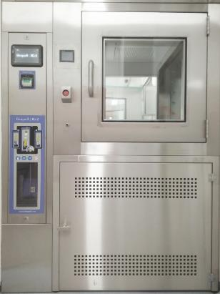

Equipment Decontamination
Click each tab to learn more.
Bioquell L-4
Bioquell IG-2
Integrated touch screen
Bioquell IG-2 is available in four separate modules:
HMI Screen (additional if required)
Printer
RFID Bottle Housing
Vaporiser / Generator
Integrated Printer
Integrated Bottle Housing
The Bioquell IG-2
vaporizer
Notes:
Unlike Bioquell L-4, Bioquell IG-2 is available in four separate modules, they are:
HMI Screen
Printer
RFID Bottle Housing
Vaporizer / Generator
The Vaporizer or Generator is hidden nearby to the enclosure.

Slide 45
Equipment Decontamination
Click each tab to learn more.
Bioquell L-4
Bioquell IG-2
Enclosure / zone bio-decontamination applications:
Compact, multipurpose mobile Hydrogen Peroxide Vapor generator designed to be integrated into customer equipment
Ideal for integration with filling lines, isolator systems and pass-throughs up to 20m³
Single or dual hydrogen peroxide bottle modules, 950mL or 2L
Easy-to-use color touchscreen
Limitations
Click Next to continue.
Notes:
Bioquell IG-2 is a compact, multipurpose mobile Hydrogen Peroxide Vapor generator designed to be integrated into customer equipment. Ideal for integration with filling lines, isolator systems and pass-throughs up to 20m³ .It comes in single or dual hydrogen peroxide bottle modules i.e. 950mL or 2L and has a color touchscreen.
Click the Limitations tab to learn more.

Slide 46
Equipment Decontamination
Click each tab to learn more.
Bioquell L-4
Bioquell IG-2
Enclosure / zone bio-decontamination applications:
Compact, multipurpose mobile Hydrogen Peroxide Vapor generator designed to be integrated into customer equipment
Ideal for integration with filling lines, isolator systems and pass-throughs up to 20m³
Single or dual hydrogen peroxide bottle modules, 950mL or 2L
Easy-to-use color touchscreen
X
Limitations
Not portable like L-4
Small catalyst
Limitations

Slide 47

Bioquell Enclosure Application
Click each number to view what it is.
Isolator system design
3
9
8
4
7
2
1
6
5
10
11
Notes:
Shown here is the typical isolator system design.
Click each number to view what it is.

Slide 48
Bioquell Enclosure Application
Click each number to view what it is.
Isolator system design
High Level H2O2 Sensor Mount
3
Client’s Supply Pipe
9
8
Client's Return Hose
Rotating Nozzle
4
Bioquell Generator
Return Hose
2
Supply Hose
7
1
Low Level H2O2 Sensor Port
5
Pressure Control Tap & Tube
6
Volt Free & Remote Start / Stop Contacts
10
Ethernet Connection for Data Transfer
11
Click Next to continue.

Slide 49
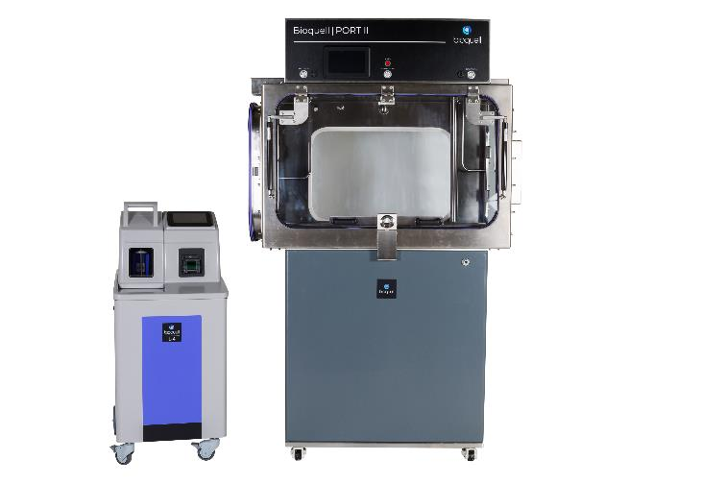
Bioquell PORT II
New graphical HMI
Door status indicators
Interface for connections with external equipment
Front door for loading complete with inflatable seals
Bioquell L-4
generator
High speed aeration catalyst
Click Next to continue.
Notes:
The Bioquell Port II offers rapid, secure material transfers into aseptic environments to eliminate the risk of process contamination. Rapidly create and retain an aseptic environment by connecting the enclosure to a Bioquell hydrogen peroxide vapor system such as the Bioquell L-4. With integrated aeration, decontamination cycles in the Bioquell Port II are fast, reliable and repeatable.
Take a minute look at it features.

Slide 50

Course Structure
✓
✓
✓
✓
✓
Our Technology
Systems for
Rooms
Solutions for
Healthcare
RBDS
Systems for
Enclosures
Bioquell Qube
Summary
Notes:
Let’s now learn in detail about Bioquell Qube.

Slide 51
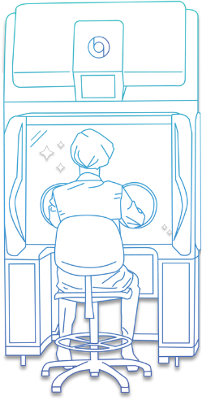



The Bioquell Qube
Bioquell Qube:
Is a flexible, modular aseptic processing workstation
Is available in 2, 4, or 6 glove configurations with up to two transfer chambers
Can operate in negative or positive pressure
Has validated rapid cycles with 6-log bio-decontamination
Is a software to enable compliance with 21 CFR Part 11 and Eudralex Vol. 4 Annex 11 regulations
TRANSFER CHAMBER
TRANSFER CHAMBER
2 GLOVE
4 GLOVE
6 GLOVE
Integrated Bioquell technology creates ISO 5 / EU Grade A working environment.
Click Next to continue.
Notes:
What is a Bioquell Qube?
It is a flexible, modular aseptic processing workstation with numerous uses which is available in 2, 4, or 6 glove configurations with up to two transfer chambers. It can operate both in negative and positive pressure. It has validated rapid cycles with 6-log bio-decontamination is a software to enable compliance with 21 CFR Part 11 and Eudralex Vol. 4 Annex 11 regulations.
Integrated Bioquell technology creates ISO 5 / EU Grade A working environment.

Slide 52
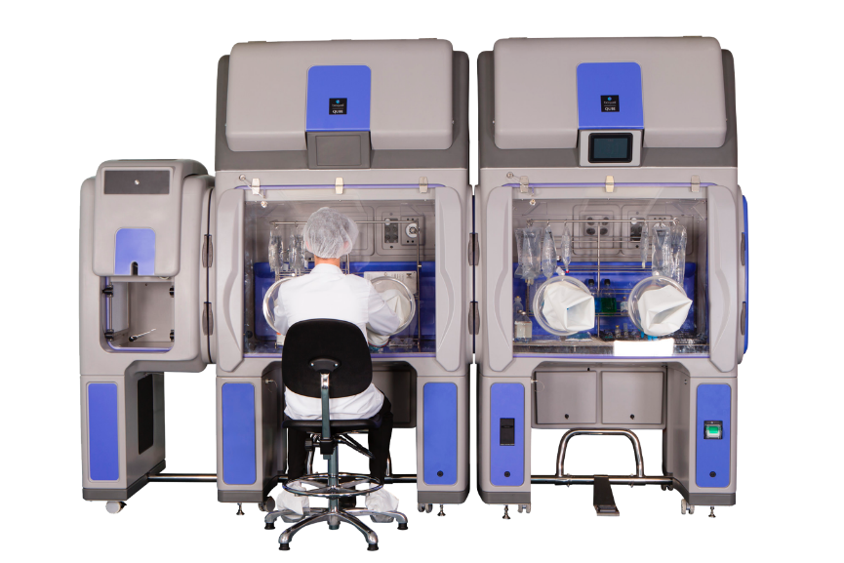



Qube Applications
Compounding Pharmacies
Biopharmaceutical Production
Cell Therapy
Integrated Bioquell technology creates ISO 5 / EU Grade A working environment.
Click Next to continue.
Notes:
The three applications of Bioquell Qube include compounding pharmacies, biopharmaceutical production and cell therapy.

Slide 53






Unique Selling Points
Click each icon to read more.
Click Next to continue.
Notes:
Click each icon to read about the Biouell’s unique selling points.

Slide 54




Unique Selling Points
Click each icon to read more.
RAPID cycles with integrated Bioquell decontamination technology
UNIQUE polypropylene construction
INSTALLED and VALIDATED in a fraction of the time of traditional isolators from order date
NO construction needed for installation
PLUGS into a standard outlet
More COST EFFECTIVE than traditional options
Click Next to continue.

Slide 55
Course Structure
✓
✓
✓
✓
✓
✓
Our Technology
Systems for
Rooms
Solutions for
Healthcare
RBDS
Systems for
Enclosures
Bioquell Qube
Summary
Notes:
We’ve come to the end of the course. Let’s briefly summarize.

Slide 56
Summary
Technology
RBDS
Systems for
Rooms
Systems for
Enclosures
Solutions for
Healthcare
Bioquell Qube
Notes:
Let's summarize what we have covered.
Click each tab for a quick recap.

Slide 57
Summary
Technology
RBDS
35% Hydrogen Peroxide Vapor Technology
Validated, 6-log sporicidal kill on every exposed surface
Wide efficacy spectrum against bacteria, viruses, spores and more
Breaks down into residue free oxygen and water
Compatible with sensitive materials and products
Systems for
Rooms
Systems for
Enclosures
Solutions for
Healthcare
Bioquell Qube

Slide 58
Summary
Technology
RBDS
Bioquell systems include:
Bioquell Z-2
Bioquell ProteQ
Bioquell SeQure
Fixed Room Decontamination
Bespoke Fixed Systems
Systems for
Rooms
Systems for
Enclosures
Solutions for
Healthcare
Bioquell Qube

Slide 59
Summary
Technology
RBDS
Systems for
Rooms
Systems for
Enclosures
Bioquell BQ-50
For use in patient rooms, bays and operating theatres
Bioquell Pod
Enables conversion of open clinical areas into single patient occupancy spaces, preventing the spread of infection between patients
Solutions for
Healthcare
Bioquell Qube

Slide 60
Summary
Technology
RBDS
Bioquell equipment and engineers perform decontamination responsibilities for scheduled or emergency situations with detailed reporting.
Completely scalable due to unique RBDS networking capabilities and specialized equipment
Systems for
Rooms
Systems for
Enclosures
Solutions for
Healthcare
Bioquell Qube

Slide 61
Summary
Technology
RBDS
Systems for
Rooms
Systems for
Enclosures
The Bioquell L-4 and the Bioquell IG-2 offer a mobile and integrated solution respectively.
Solutions for
Healthcare
Bioquell Qube

Slide 62
Summary
Technology
RBDS
Systems for
Rooms
Systems for
Enclosures
Bioquell Qube:
Is a flexible, modular aseptic processing workstation
Is available in 2, 4, or 6 glove configurations with up to two transfer chambers
Can operate in negative or positive pressure
Has validated rapid cycles with 6-log bio-decontamination
Is a software to enable compliance with 21 CFR Part 11 and Eudralex Vol. 4 Annex 11 regulations
Solutions for
Healthcare
Bioquell Qube
Click Next to continue.

Slide 63
Congratulations!
You’ve successfully completed
‘Bioquell Introduction’
EXIT
Notes:
Congratulations!
You’ve successfully completed ‘Bioquell Introduction’ course.
Please click the Exit button to close the window!

